Slide 1
Chapter 3 Introduction to Database Transactions

Slide 2
Introduction to Transaction Processing
Based on the number of users who can use the system concurrently, database systems can be classified as:
Single-User System:
At most one user at a time can use the database management system.
Eg. Personal computer system
Multiuser System:
Many users can access the DBMS concurrently.
Eg. Air line reservation, Bank and the like system are operated by many users who submit transaction concurrently to the system
This is achieved by multiprogramming , which allows the computer to execute multiple programs/processes at the same time.

Slide 3
Introduction…
Concurrency
Interleaved processing:
A single central processing unit (CPU) executes at most one process at a time.
However, multiprogramming operating systems execute some commands from one process, then suspend that process and execute some commands from the next process, and so on.
Therefore, concurrent execution of processes in a single CPU is interleaved.
Advantages:
keeps the CPU busy when the process requires I/O by switching to execute another process rather than remaining idle during I/O time
prevents long process from delaying other processes.
Parallel processing:
If the computer system has multiple hardware processors (CPUs), parallel processing of multiple processes is possible.
If Processes are concurrently executed in multiple CPUs.

Slide 4
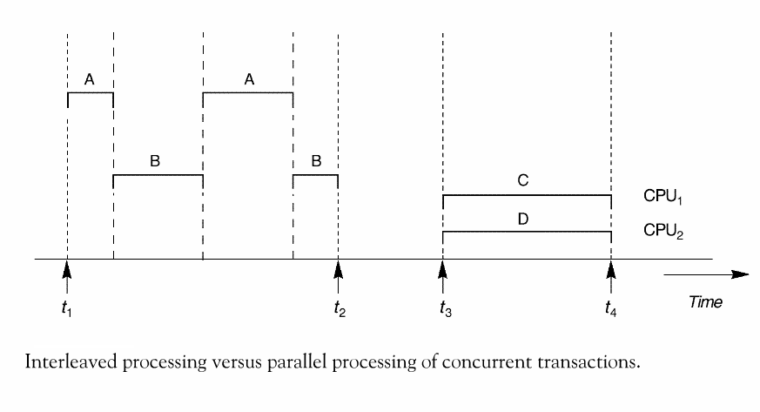
Introduction…

Slide 5
Introduction…
A Transaction:
Logical unit of database processing that includes one or more access operations (read -retrieval, write - insert or update, delete).
Examples include ATM transactions, credit card approvals, flight reservations, hotel check-in, phone calls, supermarket canning, academic registration and billing.
Database before transaction and after transaction must be in consistent state.
Transaction boundaries:
Any single transaction in an application program is bounded with Begin and End statements.
An application program may contain several transactions separated by the Begin and End transaction boundaries.

Slide 6
Introduction…
SIMPLE MODEL OF A DATABASE :
A database is a collection of named data items
The size of a data item is called its Granularity – It may be a field, a record , or a whole disk block that measure the size of the data item
Basic operations that a transaction can perform are read and write
read_item(X): Reads a database item named X into a program variable. To simplify our notation, we assume that the program variable is also named X.
write_item(X): Writes the value of program variable X into the database item named X.

Slide 7
Introduction…
Basic unit of data transfer from the disk to the computer main memory is one block.
In general, a data item (what is read or written) will be the field of some record in the database, although it may be a larger unit such as a record or even a whole block.
read_item(X) command includes the following steps:
Find the address of the disk block that contains item X.
Copy that disk block into a buffer in main memory (if that disk block is not already in some main memory buffer).
Copy item X from the buffer to the program variable named X.

Slide 8
Introduction…
write_item(X) command includes the following steps:
Find the address of the disk block that contains item X.
Copy that disk block into a buffer in main memory (if that disk block is not already in some main memory buffer).
Copy item X from the program variable named X into its correct location in the buffer.
Store the updated block from the buffer back to disk (either immediately or at some later point in time).

Slide 9
The DBMS maintains a number of buffers in the main memory that holds data base disk blocks which contains the database items being processed.
When these buffers are all occupied and
if there is a need for additional database block to be copied to the main memory ; some buffer management policy is used to choose for replacement but if the chosen buffer has been modified, it must be written back to disk before it is used.

Slide 10
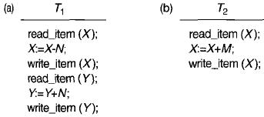
Introduction…
Two sample transactions
(a) Transaction T1
(b) Transaction T2
A=300 B=400
Assume we want to transfer from acount1 to account 2
T1 T2
Read(A) Read(B)
A=A-100 B=B+100
Write(A) Write(B) B=500
A=200 B=500
Before Transaction=300+400 =700
After Transaction =200+500=700 which consistent state

Slide 11
Introduction…
Transactions submitted by various users may execute concurrently and may access and update the same database items.
If this concurrent execution is uncontrolled, it may lead to problems, such as an inconsistent database.
Concurrency control and recovery mechanisms are mainly concerned with the database access commands in a transaction to address such problems.

Slide 12
Transaction Properties
To ensure data integrity, DBMS should maintain the following ACID properties:
Atomicity: A transaction is an atomic unit of processing; it is either performed all transaction or not performed at all.
Abort :- changes made to database is not visible(not saved)
Commit :-changes made to database is visible
Consistency (correctness): A correct execution of the transaction must take the database from one consistent state to another.
Isolation: A transaction should not make its updates visible to other transactions until it is committed; this property, when enforced strictly, solves the temporary update problem and makes cascading rollbacks of transactions unnecessary.
When there is no interaction between different transaction
Durability or permanency: Once a transaction changes the database and the changes are committed, these changes must never be lost because of subsequent failure.
Consistency in values of transactions

Slide 13
Example:
Properties…
Suppose that Ti is a transaction that transfer 2000 birr from account CA2090( which is 5000 Birr) to SB2359(which is 3500 birr) as follows
Read(CA2090)
CA2090= CA2090-2000
Write(CA2090)
Read(SB2359)
SB2359= SB2359+2000
Atomicity- either all or none of the above operation will be done – this is materialized by transaction management component of DBMS
Consistency-the sum of CA2090 and SB2359 be unchanged by the execution of Ti i.e 8500- this is the responsibility of application programmer who codes the transaction
Isolation- when several transaction are being processed concurrently on a data item they may create many inconsistent problems. So handling such case is the responsibility of Concurrency control component of the DBMS
Durability - once Ti writes its update this will remain there when the database restarted from failure . This is the responsibility of recovery management components of the DBMS

Slide 14
Transaction States
A transaction is an atomic unit of work that is either completed in its entirety or not done at all.
For recovery purposes, the system needs to keep track of when the transaction starts, terminates, and commits or aborts.
Transaction states:
Active state -indicates the beginning of a transaction execution
Partially committed state -shows the end of read/write operation but this will not ensure permanent modification on the database
Committed state -ensures that all the changes done on a record by a transaction were done persistently
Failed state happens when a transaction is aborted during its active state or if one of the rechecking is fails
Terminated State -corresponds to the transaction leaving the system

Slide 15
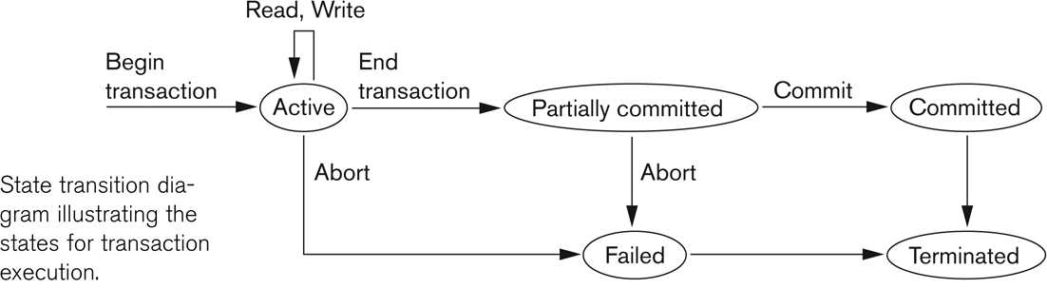
State transition diagram illustrating the states for transaction execution
States …

Slide 16
Why Concurrency Control is needed:
Concurrency :- executing multiple transaction at a time.
Simultaneous execution of transaction over shared database can create several data integrity and consistency problems
Advantages:-
Waiting time decrease
Response time decrease
Resource utilization increase
Efficiency increase
But there are 3 main problems

Slide 17
CON’T…
1. Reading uncommitted data(WR conflict “dirty read )
This occurs when one transaction updates a database item and then the transaction fails for some reason
A=5 assume A+1
T1 | T2
R(A) = 5 W(A) = 6 R(B) W(B) Abort | R(A) = 6 committed but reads value stored in local buffer.(dirty read) It reads before transaction completes.

Slide 18
CON’T…
2. Unrepeatable read (Rw conflict )
If one transaction is calculating an aggregate summary function on a number of records while other transactions are updating some of these records, the aggregate function may calculate some values before they are updated and others after they are updated
A=10 assume A+5
T1 | T2
R(A) = 10 A+5 W(A) =15 | R(A) =10 Confusion R(A) = 15

Slide 19
CON’T…
2. The Lost Update Problem (WW conflict )
This occurs when two transactions that access the same database items have their operations interleaved in a way that makes the value of some database item incorrect.
A=10 assume A+5
T1 | T2
R(A) = 10 A+5 W(A) =15 | W(A) without reading it simply write :-blind write =10 (reading some where value)

Slide 20
Schedules
Schedule – a sequences of instructions that specify the chronological order
in which instructions of concurrent transactions are executed
a schedule for a set of transactions must consist of all instructions of those transactions
must preserve the order in which the instructions appear in each individual transaction.
Types of schedule
Serial Schedule
Schedule where operations of each transaction are executed consecutively without any interleaved operations from other transactions.
Inconsistency not present here
S1:- t1,t2 or
S2:- t2,t1

Slide 21
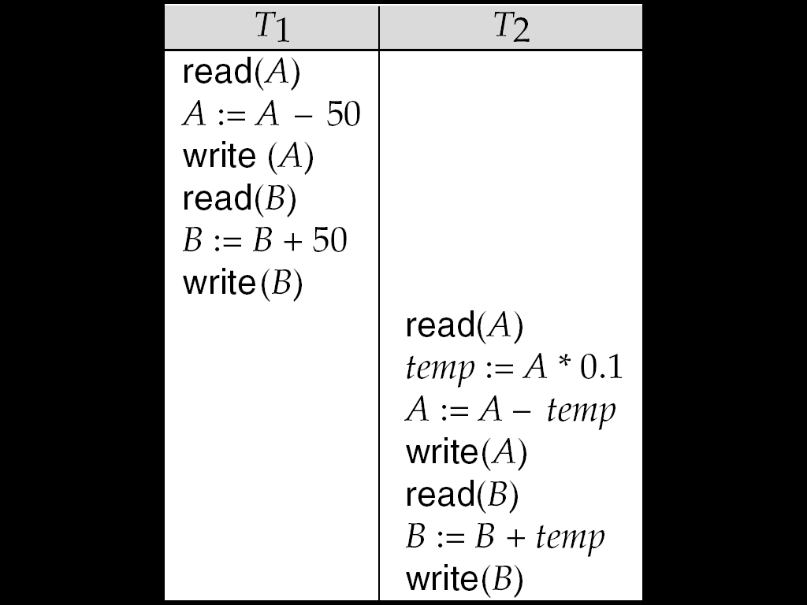
Schedule 1
Let :
T1 transfer $50 from A to B, and
T2 transfer 10% of the balance from A to B.
A serial schedule in which T1 is followed by T2:

Slide 22
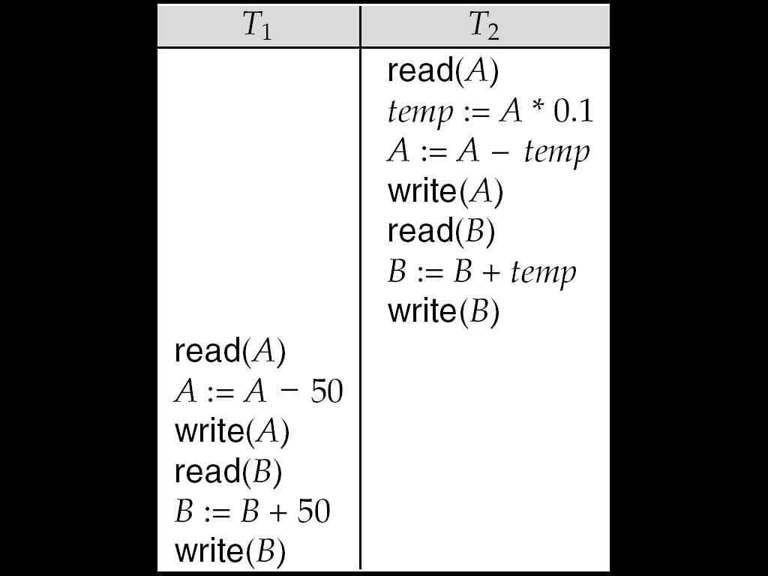
Schedule 2
A serial schedule where T₂ is followed by T₁

Slide 23
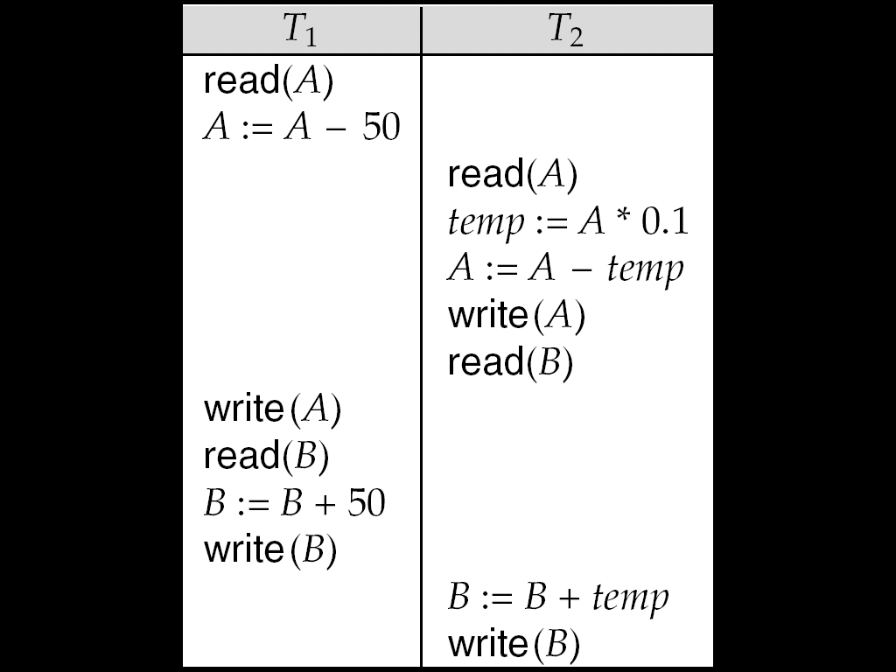
Schedule 3
The following concurrent schedule
serializable schedule (conflict serilizable and view serializable)
Non-serilizable shedule (revocable and non revocable)
Using context switch
does not preserve the value of (A + B). Not in consistent state

Slide 24
Serializability
Objective of a concurrency control is to schedule transactions in such a way as to avoid any interference.
Serializability identifies whether concurrent schedule is produce consistence result or not
A serializable schedule over a set S of committed transactions is a schedule whose effect on any consistent database instance is guaranteed to be identical to that of some complete serial schedule over S.
Serializable schedule: A schedule S is serializable if it is equivalent to some serial schedule of the same transactions

Slide 25
Serializability
Conflict serializablilty: if concurent schedule converted to serial shedule by swaping non-conflicting operation then its called conflict serializable schedule.

Slide 26
Con;t
Non Conflict serializable:
Conflict serializable
T1 | T2
R(A) | R(B)
W(A) | W(B)
R(B) | W(A)
R(A) | W(B)
T1 | T2
R(A) | W(A)
W(A) | R(A)
W(A) | W(A)

Slide 27
Con;t
Equivalent Schedule(since Schedule S is converted to S’ by serial swaps of non conflicting instruction)
The following operation are conflicting schedule
S S'
T1 | T2
R(A)
W(A)
 | R(A)
R(B)
 | W(A)
W(B)
 | R(B)
 | W(B)
T1 | T2
R(A)
W(A)
R(B)
 | R(A)
W(B)
 | W(A)
 | R(B)
 | W(B)
T1 | T2
R(A)
W(A)
R(B)
W(B)
 | R(A)
 | W(A)
 | R(B)
 | W(B)
T1 | T2
R(A)
W(A)
 | R(A)
 | W(A)
R(B)
W(B)
 | R(B)
 | W(B)

Slide 28
Con;t
Non Conflict Schedule
We can not convert to S dash
S S’
Its not conflict serializable
It may produce or not produce consistence result
T1 | T2
R(A)
W(A)
 | R(A)
 | W(A)
R(A)
W(A)
T1 | T2
R(A)
W(A)
R(A)
W(A)
 | R(A)
 | W(A)

Slide 29
Con;t
T1 | T2
R(A)
A=A+100
W(A)
 | R(B)
 | B=B-200
 | W(B)
R(B)
B=B-100
W(B)
 | R(A)
 | A=A+250
 | W(A)
Example:
A=500
B=300
A+B=800
Its not conflict
Serializable
Produce consistence
result

Slide 30
Precedence Graph
Checking Conflict serializable or not?
If cycle is there its non conflicting
T1 | T2
R(A)
W(A)
 | R(B)
 | W(B)
R(B)
W(B)
 | R(A)
 | W(A)
T1
T2

Slide 31
Precedence Graph
Checking Conflict serializable or not?
Not conflict serializable
T1 | T2 | T3
R(A)
 | W(A)
 |  | W(A)
W(A)
T1
T2
T3

Slide 32
Precedence Graph
Checking Conflict serializable or not?
No cycle is here so its conflicting serializable
T1 | T2 | T3
R(A)
 |  | R(C)
 |  | W(C)
 | R(B)
R(B)
 | W(B)
 |  | W(A)
 | W(C)
T1
T2
T3

Slide 33
View serializability:
A schedule is view serializable if it is view equivalent to a serial schedule.
If the following three condition are met its view serializable
1.If transaction Ti reads the initial value of Q in schedule S the transaction Ti must in schedule S’ also read initial Value of Q.
2.For each data item Q, the transaction(if any) that perform the final write(Q)operation in schedule S must perform the final; write (Q) operation in schedule S’.
3.If transaction Ti excute reads (Q) in schedule S and that value waas produced by transaction Tj (if any) then transaction Ti must in schedulue S’ also read the vallue of Q that was produced by transaction Tj

Slide 34
View serializable
1.check conflict serializable
2.Blind write
3.check the initial read ,final write and intermediate read
its not conflict serializable(cycle is there in graph)
IR (a) – T1 – S and T1 – S’
Fw(a) T3 – S and T3 – S’
No intermidiate
So its view serializable
Blind Write
T1 | T2 | T3
R(A)
 | W(A)
W(A)
 |  | W(A)
T1 | T2 | T3
R(A)
W(A)
 | W(A)
 |  | W(A)

Slide 35
View serializable
its not conflict serializable(cycle is there in graph)
IR (a) – T1 – S and T1 – S’
Fw(a) T2 – S and T2 – S’
Intermidite Read T2-T1 for S and T1-T2 for S’ (not same)
So its not view serializable
T1 | T2
R(A)
W(A)
 | W(A)
R(A)
W(A)
 | R(A)
 | W(A)
T1 | T2
R(A)
W(A)
R(A)
W(A)
 | W(A)
 | R(A)
 | W(A)

